Slide 1
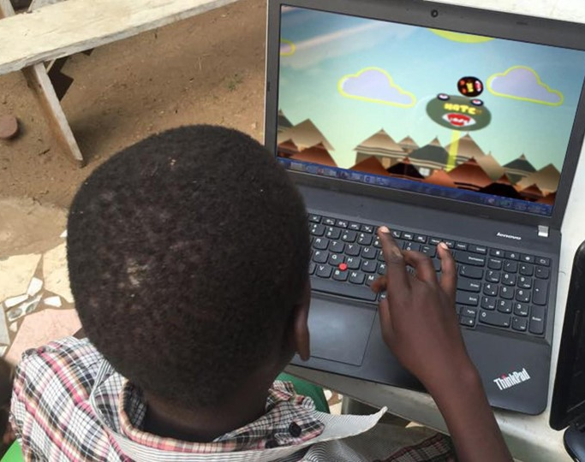
Lual Mayen fled South Sudan's civil war and learned to code in a refugee camp.

Slide 2
“Using gaming to build bridges between communities and enhance peaceful behavior”
Lual Mayen – World Economic Forum Award

Slide 3
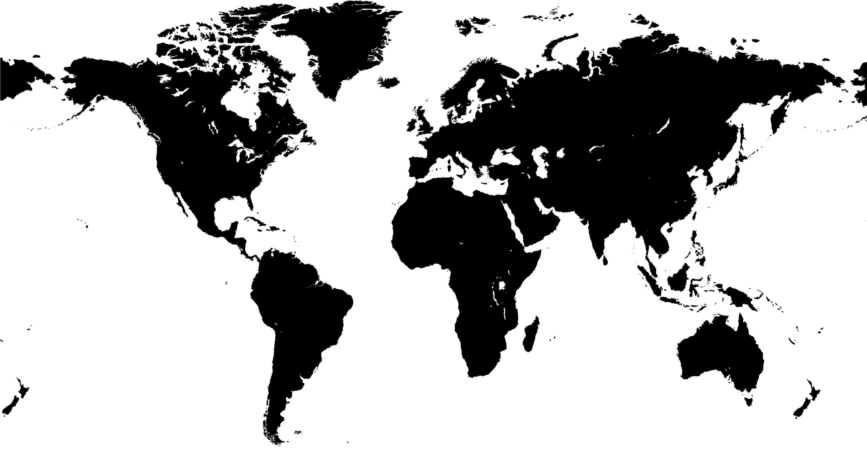
In 2011, nearly 35 million people were displaced from their home due to war, persecution or violence. That’s one of every 200 people on the planet.
MAP

Slide 4
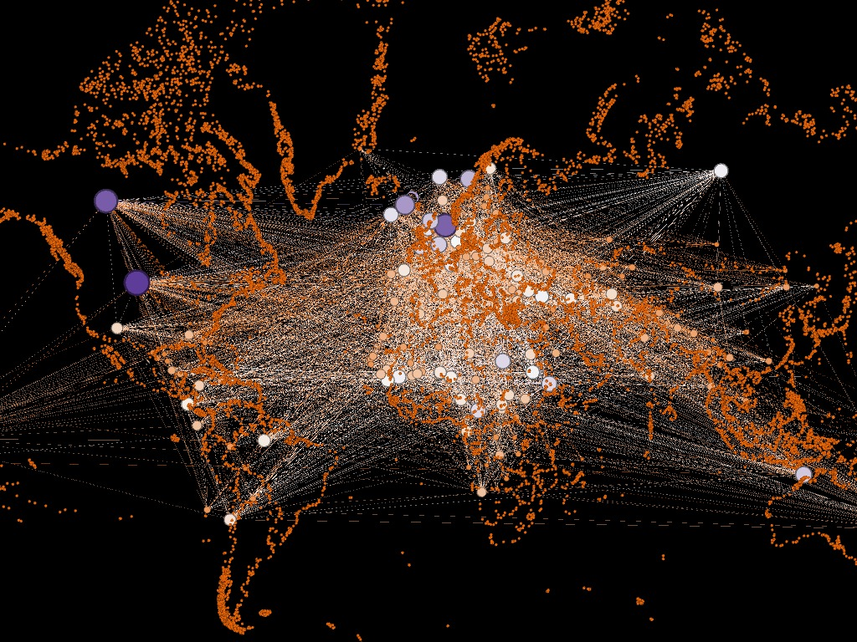
BLIND VISUALIZATION
Our Weighted Visualization

Slide 5

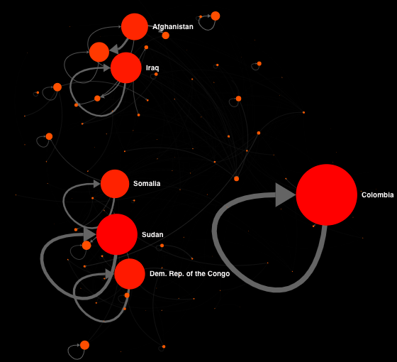
INTERNAL DISPLACEMENT
SELF - LOOPS
#1
TOTAL DEGREE
32
4958
NODES
EDGES
7,7 M
DISPLACED HABITANTS
Conflict Urbanism: Colombia
Unique Registry of Victims

Slide 6
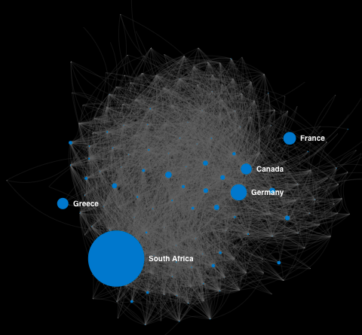

ASYLUM SAFE HEAVEN
IN
#1
WEIGHTED IN-DEGREE
220 K
65
ASYLUM SEEKERS
FROM - COUNTRIES
SOUTH AFRICA REFUGEE POLICIES

Slide 7
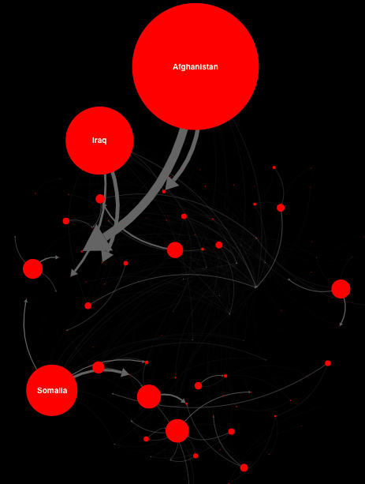
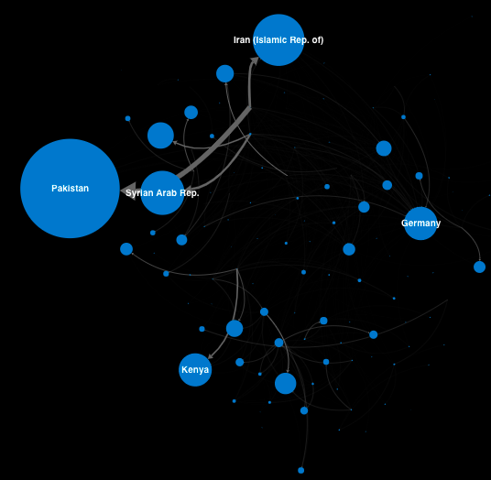

REFUGEES GATEWAY
IN
OUT
#1
BETWEENNESS
775 K
77
REFUGEES IN TRANSIT
BRIDGE FOR: COUNTRIES

Slide 8
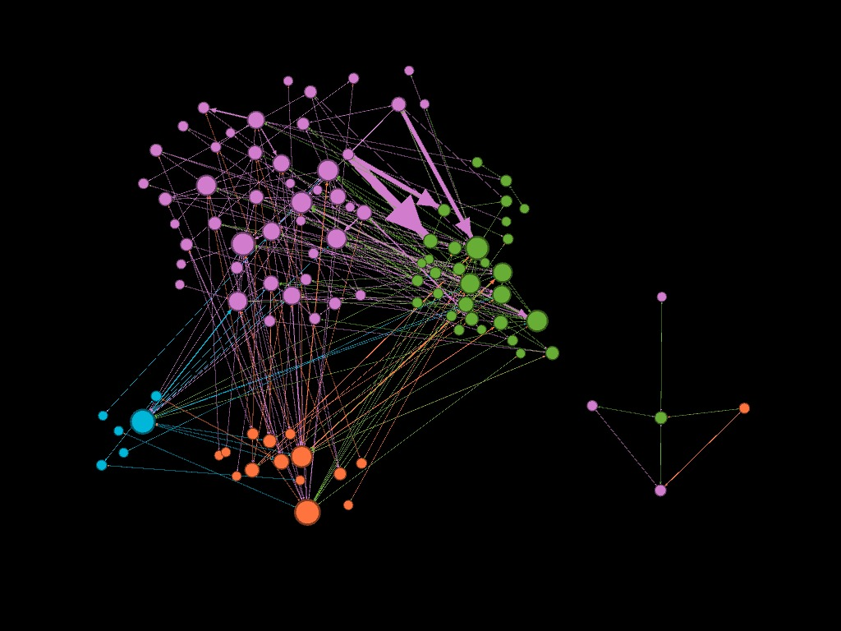
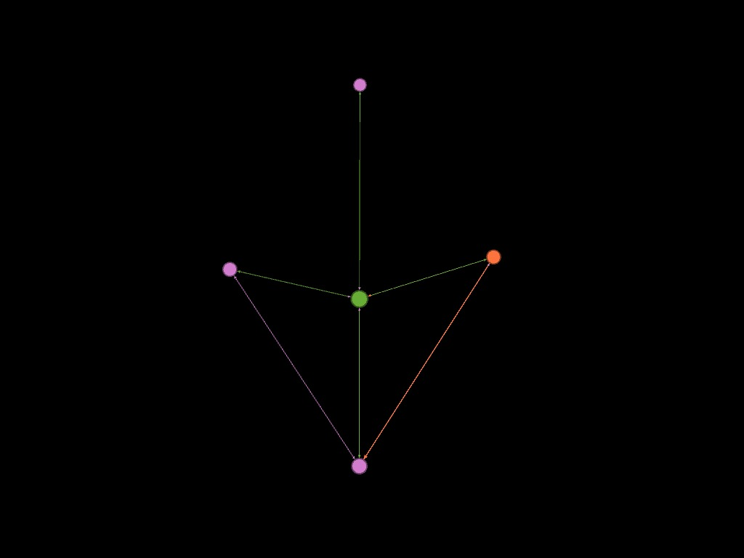
COMMUNITY DYNAMICS
26
4
COMMUNITIES - Louvain
CLUSTER - DB Scan
MONTENEGRO
BOSNIA & HERZEGOVINA
MACEDONIA
CROATIA
SERBIA & KOSOVO
Former Yugoslavia – Transitivity

Slide 9
